Slide 1
Darshna Purbhoo
Use case Diagram.

Slide 2
College Student Enrolment
Create student profile
Create temporary Student ID
Log in
Admissions Log in
Submit application
Assess Student’s application
Student
View application status
Admissions team
Review Student’s application
Edit information
Log out

Slide 3
Student Information
Students Grades
StudentID: Varchar
StudentSurname: Char
StudentName: Char
+AssignValues()
StudentID: Varchar
StudentSurname: Char
StudentName: Char
Algebra: Int
Calculus: Int
Programming: Int
Databases: Int
+AddStudentGrades()
+DivideByFour()
+AssignGrade()
Class Diagram
Students Account to Create
StudentID: Varchar
StudentName: Char
StudentEmail: VarChar
StudentClass: VarChar
SendNotiToStudent()
CreateAccount()
RecordToStudentInfo()
SendNotiToStudent()
Grades
StudentID: Varchar
Average: Int
Grades: Char
+AssignAverage()
+AssignGrades()

Slide 4
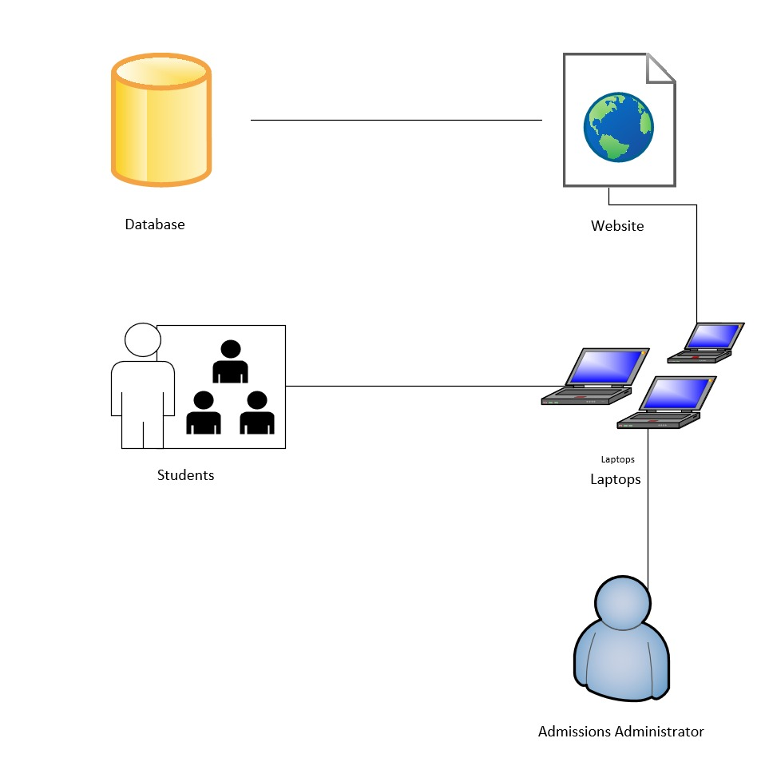

System design
Databases
Admissions Administrator

Slide 5
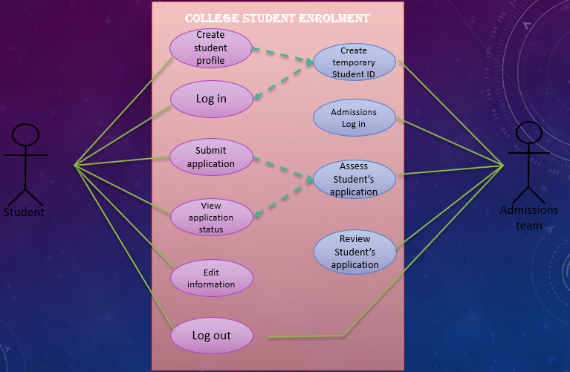
Use cases describing the process of what a student does.
Use cases describing what the admissions team does.
Shows the relationship between the student and admissions team
Primary Actor: Person who is using the system.
Secondary Actor: Retrieves application and responds.

Slide 6
Databases
Stores the data of applications and students.
Access applications via the website of the college.
Connecting point to the college website for the student application.
Submits an application as well as reviews whether or not they have been accepted.
Retrieves the applications and responds.
Admissions Administrator

Slide 7

College Enrolment System
Feature: Allows applicant to check whether they have been accepted of not.
Benefit hypothesis: Admissions administer can retrieve and respond to student.
Acceptance Criteria: Given that the student logs into the their account, they will be directed to their application to check whether they have been accepted or not.
User Story
As a student that has applied to the college, I would like to check the application status, to find out if I have been accepted or not.
Enabler story
As the administrative department, we would like to access the student’s applications and respond to it.

